Slide 1
Credit Risk Assessment
Mid-Semester Viva Presentation
M.Tech AIML Dissertation
Sudhir Suresh Zanje (2023AC05339)
HSBC Technology India • BITS Pilani

Slide 2
Project Objectives (Part 1)
Build robust baseline models using ML on available public credit datasets
Implement classifiers: Logistic Regression, Random Forest, LightGBM
Establish benchmarks with ROC-AUC, Precision, Recall, F1-score
Address class imbalance using SMOTE and class weighting

Slide 3
Project Objectives (Part 2)
Integrate Explainable AI (SHAP, LIME) for interpretability
Design deployable pipeline for banking environment
Calibrate decision thresholds for different business objectives
Quantify business impact on approval rates and default detection

Slide 4
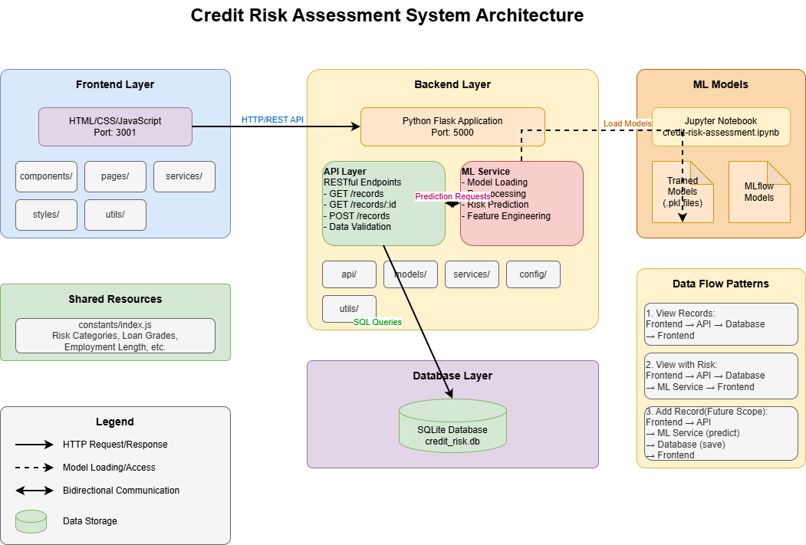
System Architecture

Slide 5
Complete Data Flow
Flow 1: View Records → Frontend → API → Database → Frontend
Flow 2: View with Risk → Frontend → API → Database → ML Service → Frontend
Flow 3: Add Record (Future) → Frontend → API → ML Service (predict) → Database
All communication through REST APIs with data validation

Slide 6
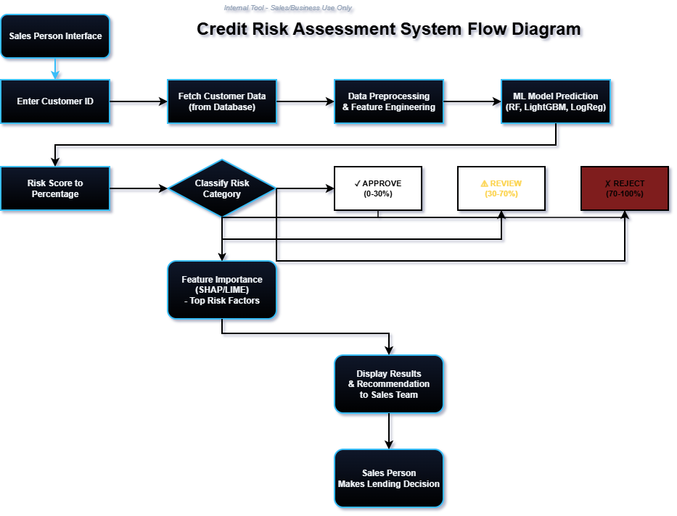
Complete Data Flow

Slide 7
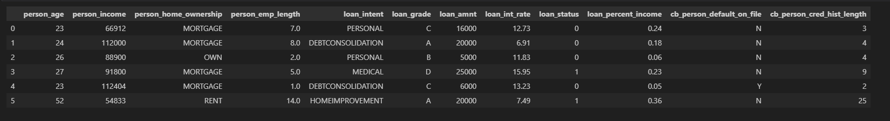
Dataset Details
Data Column details :
Data columns (total 12 columns):
# Column Non-Null Count Dtype
--- ------ -------------- -----
0 person_age 32581 non-null int64
1 person_income 32581 non-null int64
2 person_home_ownership 32581 non-null object
3 person_emp_length 31686 non-null float64
4 loan_intent 32581 non-null object
5 loan_grade 32581 non-null object
6 loan_amnt 32581 non-null int64
7 loan_int_rate 29465 non-null float64
8 loan_status 32581 non-null int64
9 loan_percent_income 32581 non-null float64
10 cb_person_default_on_file 32581 non-null object
11 cb_person_cred_hist_length 32581 non-null int64
dtypes: float64(3), int64(5), object(4)

Slide 8
Dataset Details
Feature Decsription:
person_age - Represents the applicant's age at the time of loan application.
person_income - The applicant's yearly earnings.
person_home_ownership - Housing status of the applicant, categorized as:
• rent: Currently leasing a residence
• mortgage: Property owner with an outstanding home loan
• own: Full property ownership without debt
• other: Alternative ownership arrangements
person_emp_length - Duration of current employment measured in years.
loan_intent - The purpose for which the loan is being requested.
loan_grade - Credit risk classification ranging from A (lowest risk) to G (highest risk):
• A: Excellent creditworthiness
• B: Good credit standing
• C: Average credit profile
• D: Below-average credit quality
• E: Poor credit standing
• F: Very poor creditworthiness
• G: Extremely high risk borrower
loan_amnt - Total loan amount sought by the applicant.
loan_int_rate - Annual percentage rate applied to the loan.
loan_status - Binary outcome variable (0 = repaid successfully, 1 = defaulted)
loan_percent_income - Debt-to-income ratio expressed as a percentage.
cb_person_default_on_file - Prior default history from credit bureau (Y = past defaults exist, N = clean record)
cb_preson_cred_hist_length - Number of years the individual has maintained credit accounts.

Slide 9
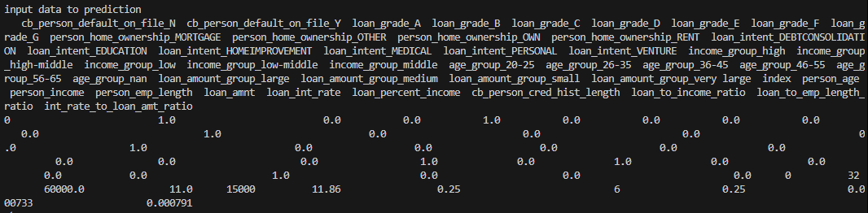
Sample Input - Customer Data
Input to ML Model:

Slide 10
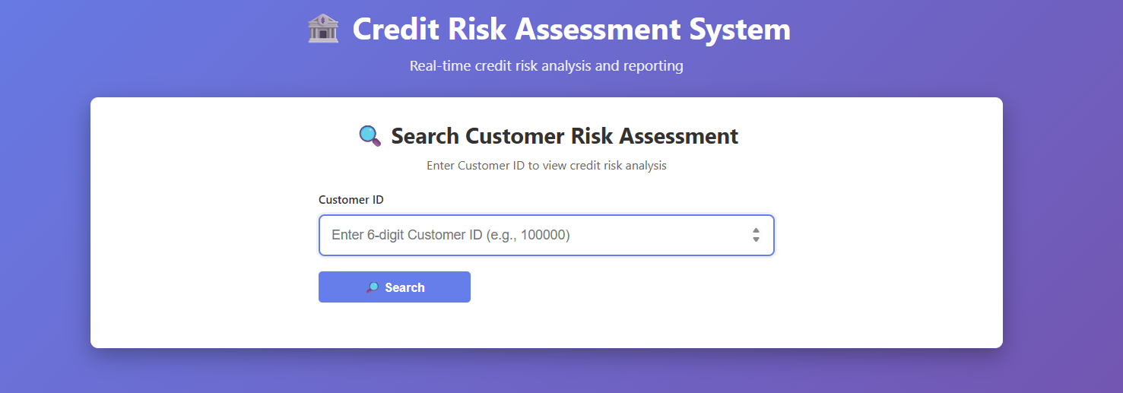
Sample Input - Customer Data
UI Input:

Slide 11
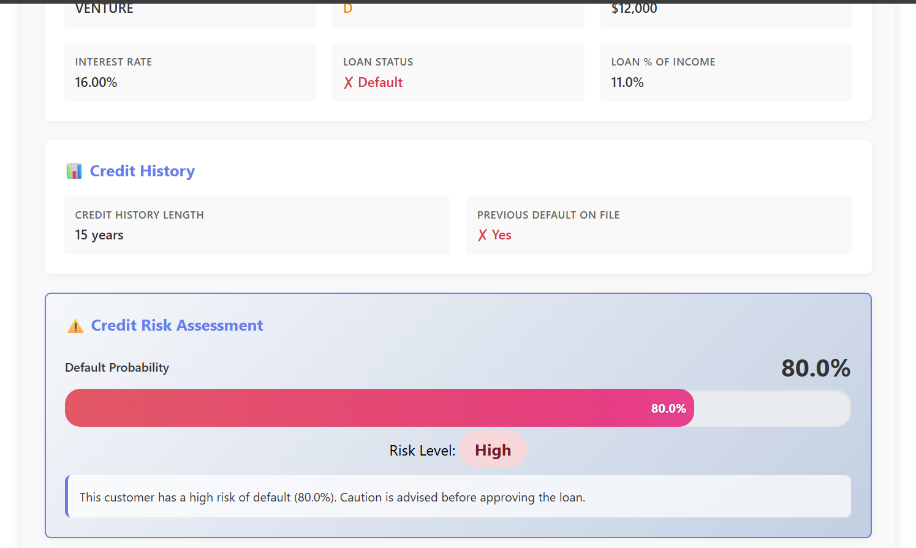
Sample Output - Risk Classification
risk parameter UI :
Top Risk Factors: Loan Grade D, Employment Length, Credit History
Categories: APPROVE (0-30%), REVIEW (30-70%), REJECT (70-100%)

Slide 12
Evaluation Metrics
Accuracy: Overall correctness (TP + TN) / Total
Precision: True defaults among predicted defaults (TP / (TP + FP))
Recall: Actual defaults correctly identified (TP / (TP + FN))
Specificity: Non-defaults correctly identified (TN / (TN + FP))

Slide 13
Testing on 1000 Inputs
Stratified test set of 1000 loan records
Class distribution maintained: ~78% good, ~22% defaults
Compute Accuracy, Precision, Recall, Specificity
Generate confusion matrix and ROC-AUC score
Analyze per-category performance (APPROVE/REVIEW/REJECT)

Slide 14
Research Papers - Key Findings
Reviewed 8 seminal papers on credit risk prediction
Best Overall Algorithm: LightGBM (AUC 0.92-0.96)
Data Handling: SMOTE/SMOTEENN for class imbalance, 700+ features
Ensemble Approach: Combining RF, XGBoost, Tabnet improves performance
Comparative Summary Table
Paper | Algorithm(s) | Best Accuracy/AUC | Unique Contribution | Data Size
1 | LightGBM | 0.705 AUC | AUC stability index | Large (Sichuan competition)
2 | XGBoost | 90.79% AUC | Feature engineering (700 vars) | 50,000 samples
3 | Random Forest | 88.3% | Algorithm comparison (4 methods) | Large dataset
4 | WGAN-GP + LightGBM | 86.7% accuracy | GAN for imbalance + LightGBM | 559 features
5 | LightGBM + SHAP + LIME | 96.1% | Explainability focus | Large bank dataset
6 | Random Forest | 90-98% | Feature importance analysis | High-dimensional
7 | LightGBM + PCA + SMOTEENN | 92.4% | Dimensionality reduction | 40,000 records
8 | DEML (RF+XGB+SVM+ANN) | 99.16% | Ensemble voting | 284,807 transactions

Slide 15
Key Research Insights Applied
Paper 5 (XAI Focus)
Paper 7 (PCA+SMOTEENN)
SHAP + LIME for interpretable predictions
Dimensionality reduction with imbalance handling

Slide 16
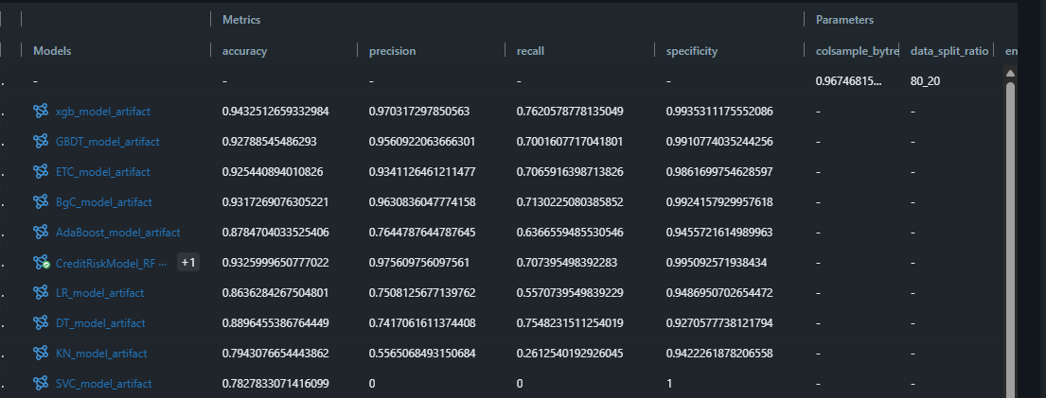
Model Performance Results
SVC: Support Vector Classifier KN: K-Neighbors Classifier (K-Nearest Neighbors) DT: Decision Tree Classifier LR: Logistic Regression RF: Random Forest Classifier
AdaBoost: AdaBoost Classifier (Adaptive Boosting) BgC: Bagging Classifier ETC: Extra Trees Classifier (Extremely Randomized Trees)
GBDT: Gradient Boosting Decision Tree (Gradient Boosting Classifier) xgb: XGBoost Classifier (Extreme Gradient Boosting)

Slide 17
Model Comparison Summary
Best Overall Performer: Random Forest (RF) achieved the highest Accuracy (93.26%) and Precision (97.56%), making it the most reliable model for minimizing false positives.
Best for Identifying Risk (Recall): The Decision Tree (DT) model had the highest Recall (75.48%). While it is less accurate overall than the ensemble models (RF, BgC), it captured the highest number of actual positive cases (credit risks).
Ensemble Dominance: Tree-based ensemble methods (Random Forest, Bagging Classifier, Gradient Boosting) consistently outperformed individual classifiers like Logistic Regression and K-Neighbors.
SVC Issue: The Support Vector Classifier (SVC) appears to have predicted the negative class for every instance (Specificity 100%, Recall 0%), indicating it failed to learn the positive class patterns with the current hyperparameters.

Slide 18
Problem 1: Feature Alignment & Inference Consistency Issue
Issue: The model prediction failed because raw input data lacked the specific feature engineering, scaling, and column ordering (e.g., One-Hot Encoded columns) required by the trained model
Impact: Models biased toward majority class
Solution:
Mirrored Pipeline: Replicated training logic (feature engineering, binning) for consistent inference.
Schema Enforcement: Enforced exact column structure to prevent shape mismatches.
Adaptive Encoding: Zero-padded missing categories to handle single-record inputs.
Unified Scaling: Applied saved StandardScaler for identical numeric transformation.

Slide 19
Problem 2: Class Imbalance
Issue: Dataset has ~78% good loans, 22% defaults
Impact: Models biased toward majority class
Solution:
Applied SMOTE (Synthetic Minority Oversampling)
Class weighting during model training
Stratified cross-validation for fair evaluation

Slide 20
Problem 3: Feature Engineering
Issue: Raw 12 features insufficient for optimal performance
Solution Implemented:
Created loan_percent_income ratio
Encoded categorical variables (home ownership, loan grade, intent)
Normalized numerical features for consistency
Selected top features using feature importance analysis

Slide 21
Problem 4: Model Selection
Issue: Choosing optimal model from multiple candidates
Resolution:
Trained 8+ models with GridSearchCV hyperparameter tuning
Evaluated using ROC-AUC, Precision-Recall, F1-score
Selected Random Forest for production (best balance)

Slide 22
Problem 5: Model Interpretability
Issue: Black-box models lack explainability for banking
Solution:
Integrated SHAP for feature importance visualization
LIME for local instance-level explanations
Generated business-friendly risk reports with justifications

Slide 23
Final Results
Best Model: Random Forest
93.25% Accuracy | 97.56% Precision | 70.73% Recall
Successfully developed for production-ready architecture

Slide 24
Deployment & Future Scope
Current Deployment: Flask REST API + SQLite
Docker containerization for scalability
CI/CD pipeline for continuous model updates
MLflow tracking for experiment versioning
Real-time monitoring with DVC for data pipelines

Slide 25
Thank You!
Questions & Discussion
Credit Risk Assessment System
Supervised by: Tom Babu (HSBC Technology India)

